Slide 1

Ch. 52 – Responsive Page
Web-design

Slide 2
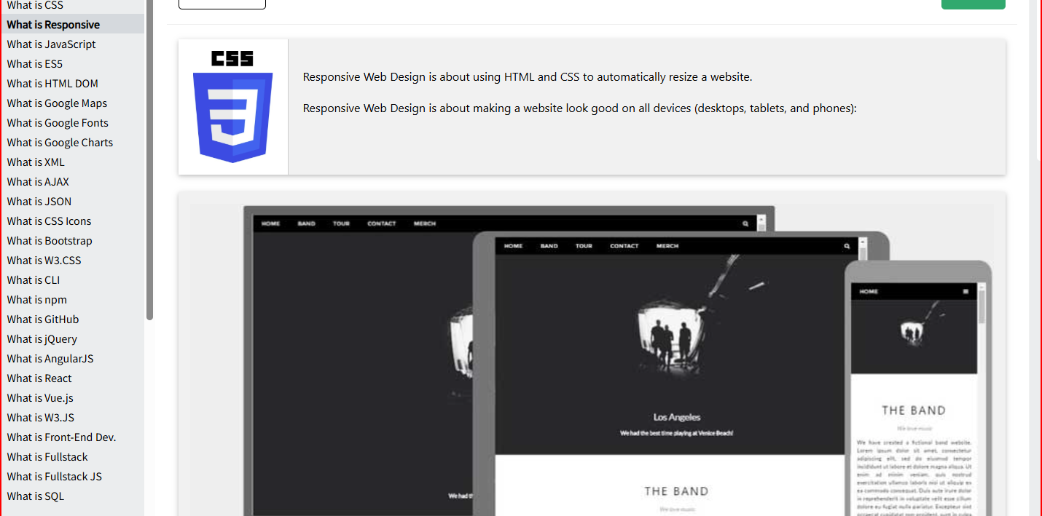
What is Responsive Web Design?

Slide 3
A responsive page in HTML is a web page that automatically adjusts its layout, content, and media to render optimally on any device, from desktops to smartphones, regardless of screen size or orientation.
It relies on a combination of the HTML viewport meta tag and CSS techniques such as flexible grids, fluid images, and media queries to ensure usability and readability across all viewports.
This approach eliminates the need for separate mobile and desktop versions of a site, providing a consistent user experience with a single codebase.

Slide 4
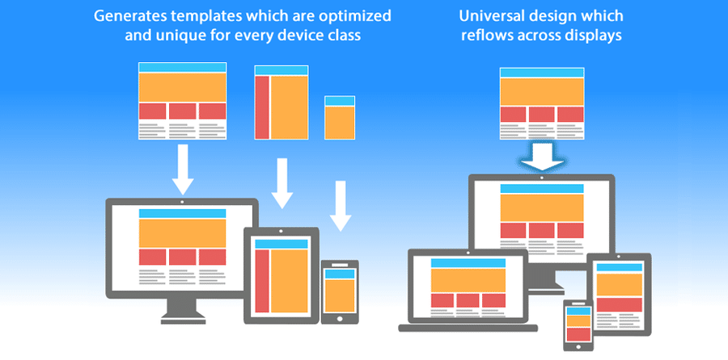

Slide 5
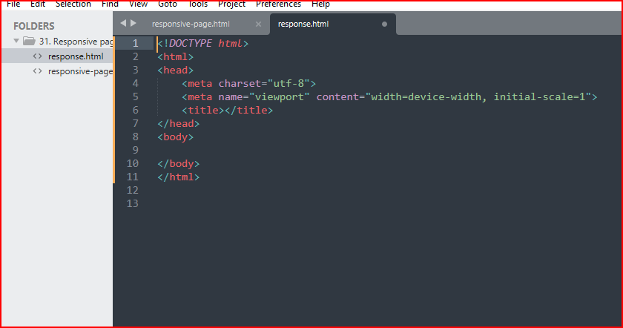
When you save your second page as an html file, you just need to click on < ht and then the TAB button, this will automatically produce the following:
<!DOCTYPE html>
<html>
<head>
<meta charset="utf-8">
<meta name="viewport" content="width=device-width, initial-scale=1">
<title></title>
</head>
<body>
</body>
</html>

Slide 6
<!DOCTYPE html>
<html>
<head>
<meta charset="utf-8">
<meta name="viewport" content="width=device-width, initial-scale=1">
<title></title>
</head>
<body>
</body>
</html>
Automatically appears when you type the first-two letters HT then TAB button: saves time retyping.
The meta-tag highlighted in yellow is called a “viewport” meta-tag.

Slide 7
<!DOCTYPE html>
<html>
<head>
<meta charset="utf-8">
<meta name="viewport" content="width=device-width, initial-scale=1">
<title></title>
</head>
<body>
</body>
</html>
The green-highlighted section shows the BROWSER how the page will appear on any device at a scale 1:1 or 0, e.g. laptop, TV, mobile phone, desktop etc.

Slide 8
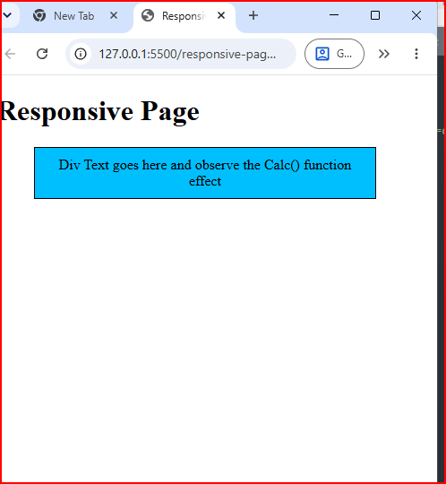
Even if we narrow the page, the text remains in the “Viewing “ area and we can read all the information on the page that is available.
Notes:
This is viewing in the Live Server (Ritwick Dey) on Visual Studio. This is what we call a responsive page.

Slide 9
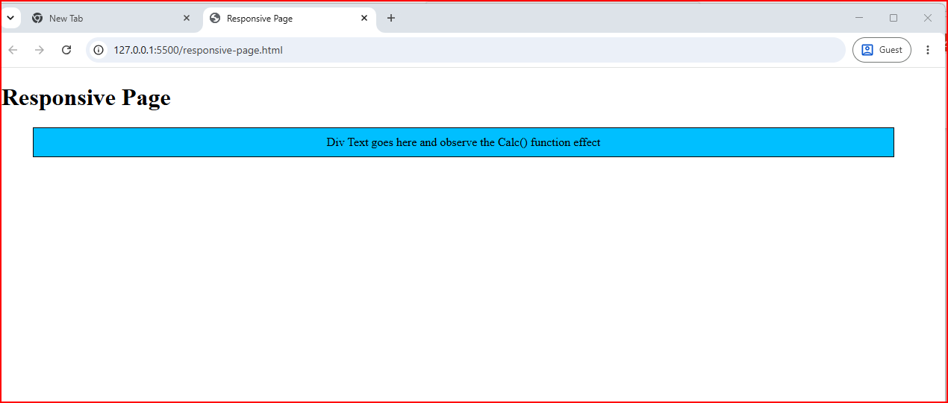
Notes:
When we open out the page to its fullest width, all the text is available to “view”. This is what we call a responsive page.

Slide 10
If you press F12 on your laptop, whilst you are in your chrome page, you will see the code for your responsive-page.

Slide 11
Viewing the page from the internet on a mobile-phone
Viewing the page on a Nokia works well, since the script relies on standard HTML, CSS, and JavaScript that any modern mobile browser reads correctly, including the browser on Nokia's Android-based models (like the Nokia G, X, or C series).
To view it from the internet, upload the HTML file to a free hosting service and open the resulting link in the phone's browser. A few simple options:
• GitHub Pages: Create a free GitHub account, upload the file to a repository, enable Pages in the settings, and get a live URL. • Netlify Drop: Go to app.netlify.com/drop, drag the HTML file into the browser window, and get an instant live link with no account needed. • CodePen or JSFiddle: Paste the code into the editor, save it, and share the live preview link directly to the phone.
Once the page loads on the Nokia, the green box in the corner shows the phone's actual screen width, height, pixel ratio, and orientation, since real devices don't need the F12 DevTools trick that desktop browsers use for emulation. Rotating the phone between portrait and landscape updates the values instantly.
Does the Nokia run Android, or is it an older feature phone model? That changes which browser it uses and how well the layout and JavaScript display.

Slide 12
You have to upload a file or a folder.
the file must be called “index.html.
Copy the file you want in a different folder, so you have the original.
4. Then change the name to index.html
5. Upload it to Netlify and Netlify will give you a internet name URL: https://app.netlify.com/projects/magical-conkies-017779/overview

Slide 13
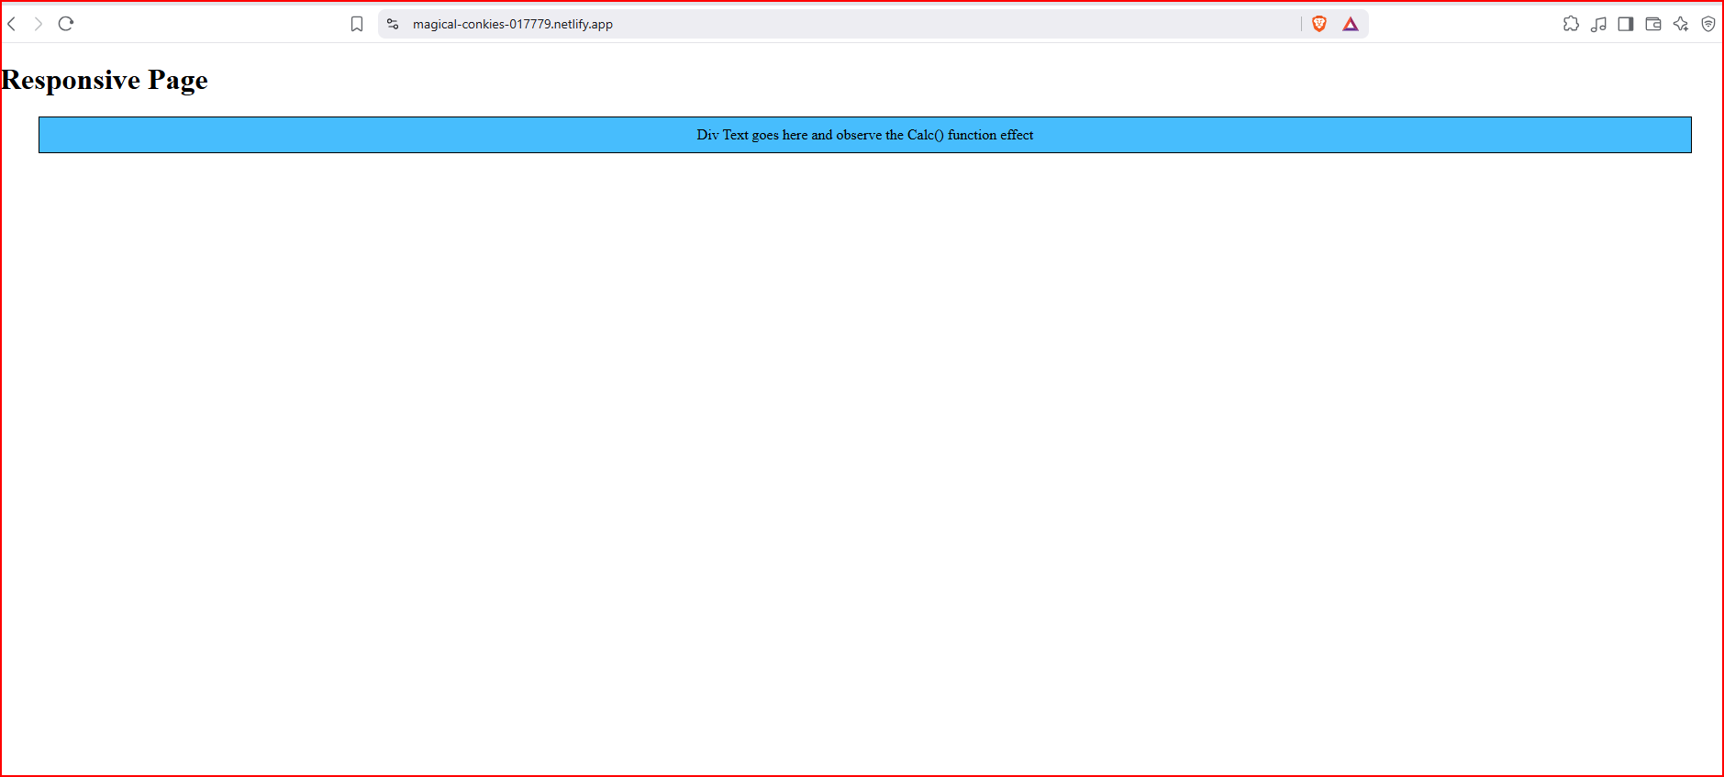
My web-page “responsive-page” in Netlify
Log-in to Netfliy with GranitAI (algol999.AI@gmail.co) Netlify is a Private Account.
Notes:
My webpage in Netfly has been give a new name: https://app.netlify.com/projects/magical-conkies-017779/overview

Slide 14
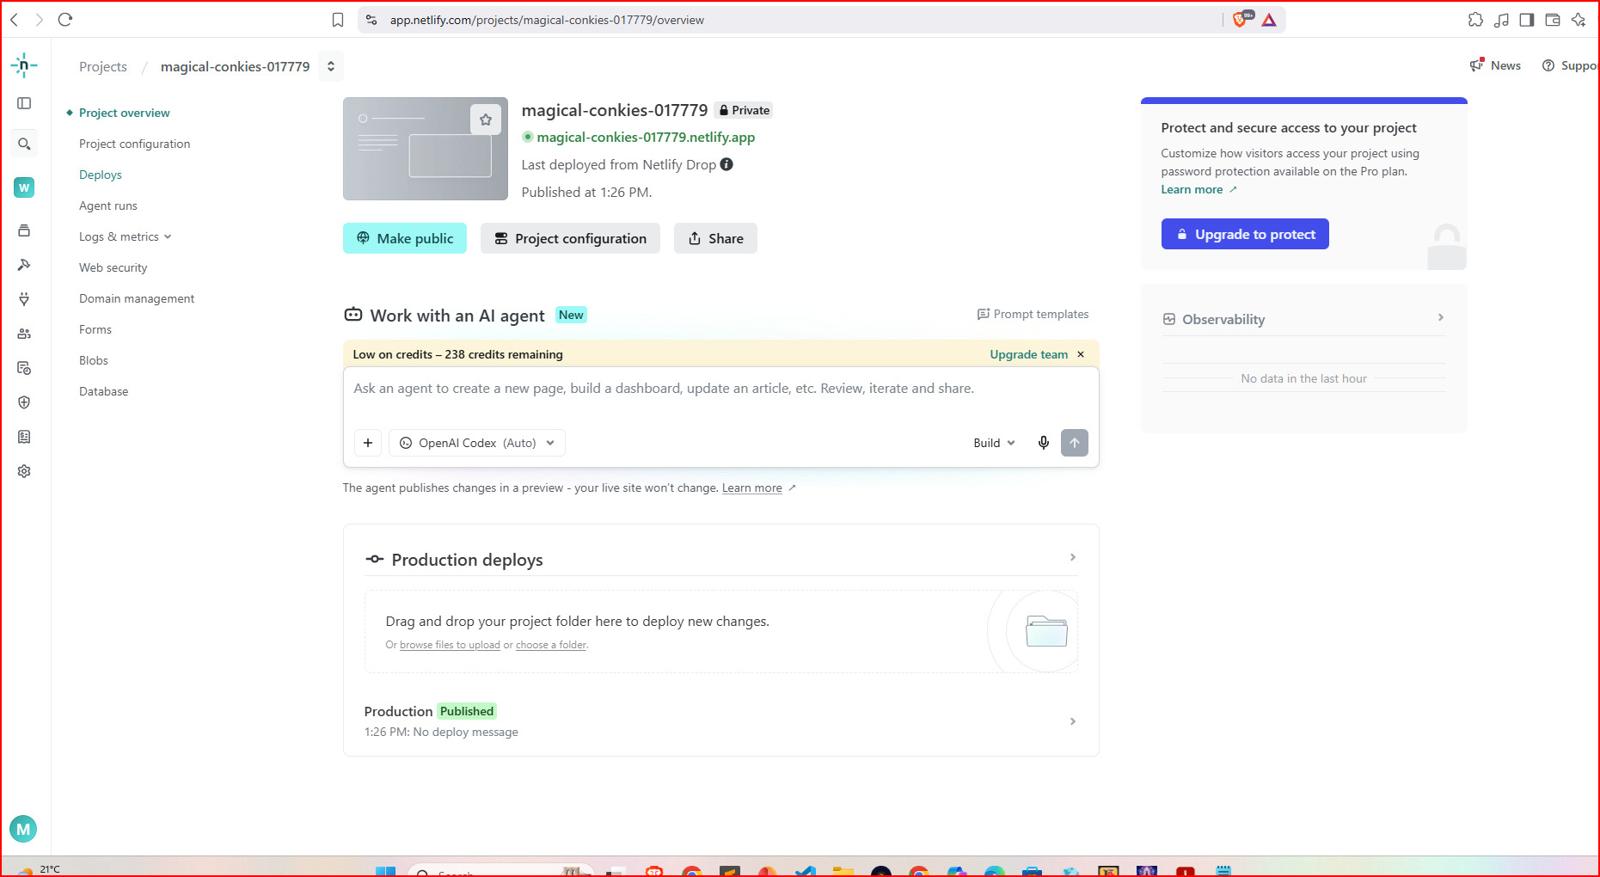
Log-in to Netfliy with GranitAI (algol999.AI@gmail.co) Netlify is a Private Account.

Slide 15
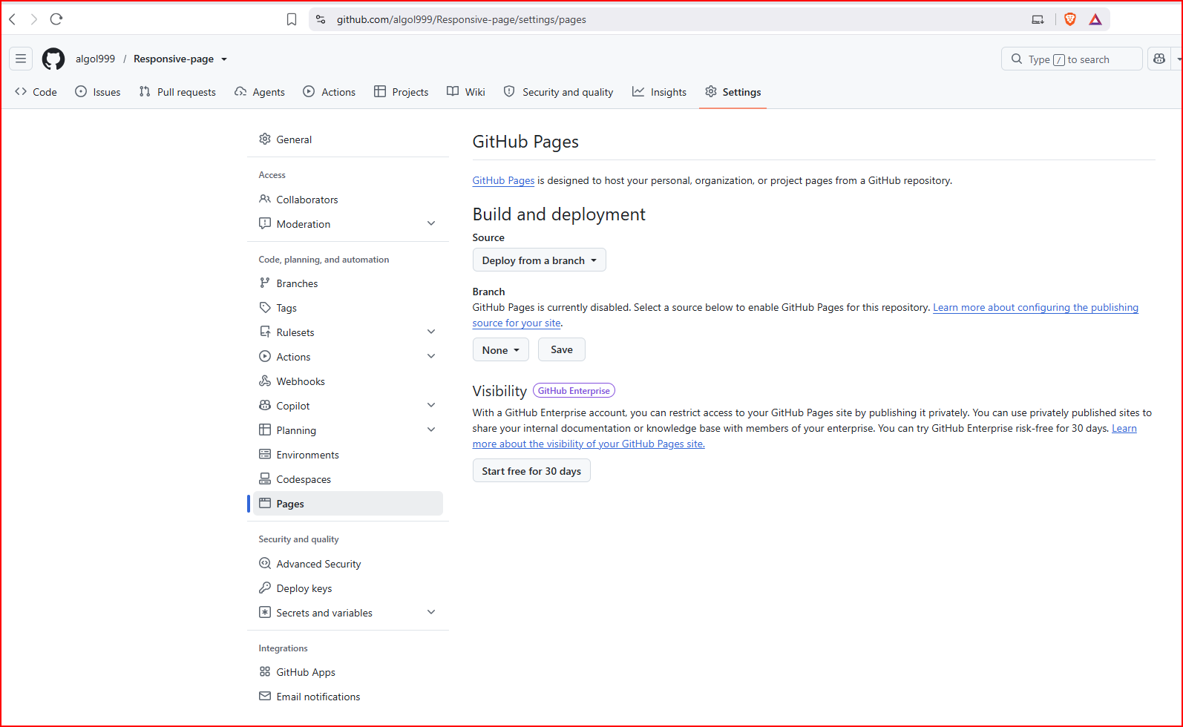
In Github : open a new account (where applicable)
create a new repository
Upload you file “index.html”
Click on “settings” next to the “code issues tab” on left-hand-side of screen.

Slide 16
Clicking "Pages" from that particular menu opens a different area, since that sidebar belongs to the account-wide settings, not a specific repository's settings. "Build and deployment" only appears inside a repository's own Pages settings.
Follow these steps instead:
Go to github.com and click the repository name directly (the one holding the index.html file), not the account settings menu.
Inside that repository page, click "Settings" (a tab near the top of the repository, alongside "Code," "Issues," and "Pull requests").
In the left sidebar of the repository settings, click "Pages."
"Build and deployment" appears there, with a "Branch" dropdown to select "main" and a folder option set to "/ (root)."
The account-wide "Code, planning, and automation" menu (the one showing Repositories, Codespaces, Packages, Copilot, Pages, Saved replies) controls general account features and doesn't hold the deployment settings for an individual project. Navigating into the specific repository first, then its own Settings tab, brings up the correct Pages screen with the "Build and deployment" section visible.
Try that path and let me know once the "Branch" dropdown shows up.
Notes:
4. "Build and deployment" appears there, with a "Branch" dropdown to select "main" and a folder option set to "/ (root)."

Slide 17
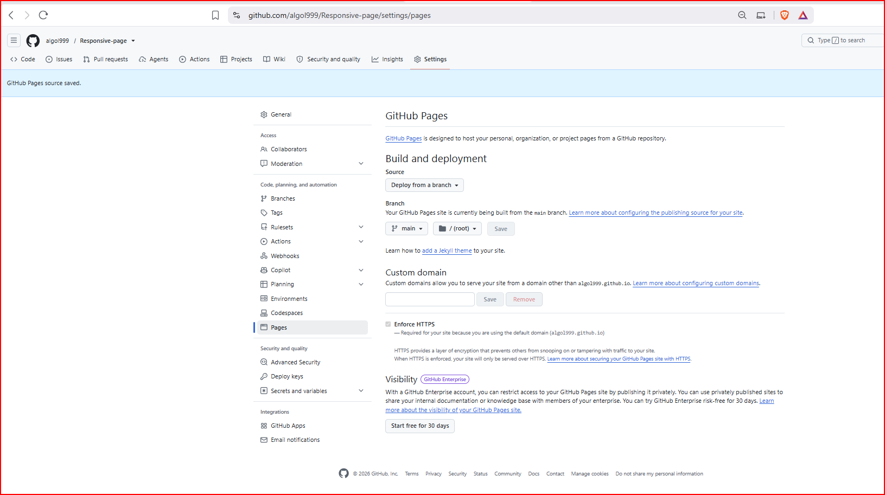
Notes:
"Build and deployment" appears there, with a "Branch" dropdown to select "main" and a folder option set to "/ (root)."

Slide 18
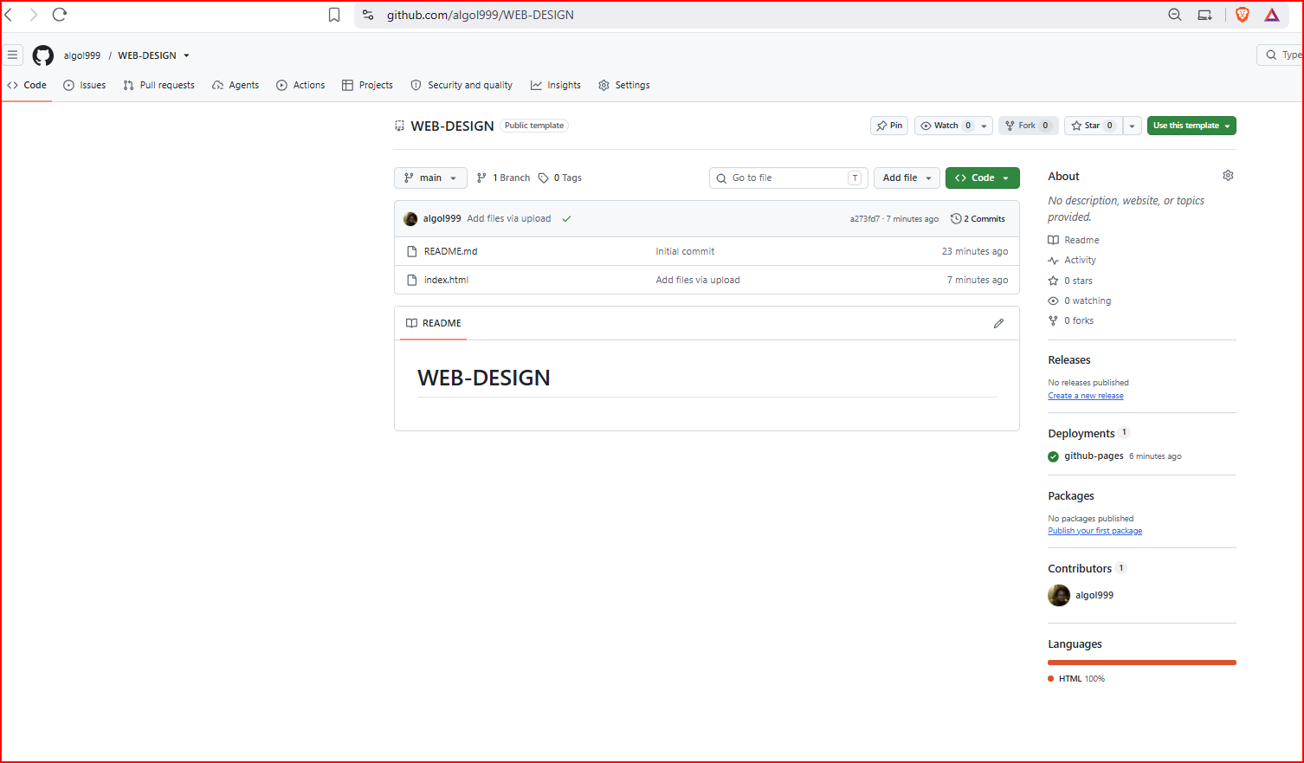
I created new repository in Git-hub. You have to wait ten minutes for it to go live.
Notes:
Make sure the DANGER-ZONE settings are set to public, so you can see your web-page on the internet.

Slide 19
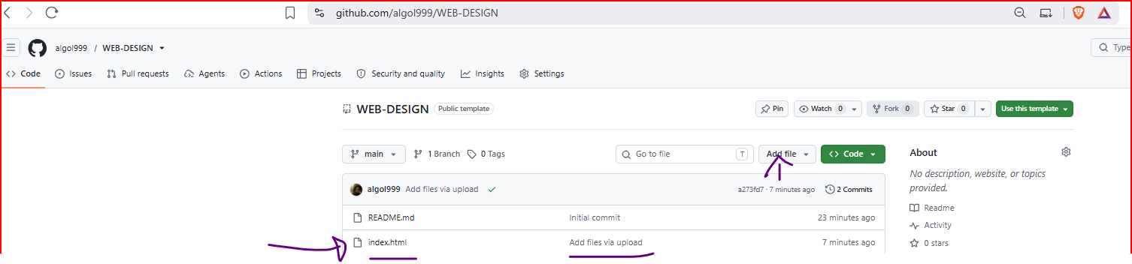
I uploaded my “index.html” folder.
I added a profile photo to my Github Account.
Make sure the file you are uploading is NOT in a folder.
Click on my “index.html” file.
The page will open and you will see a green tick next to it, to confirm is live on internet.
The URL is: https://algol999.github.io/WEB-DESIGN/
This is the template address:
https://<username>.github.io/<repository-name>/

Slide 20
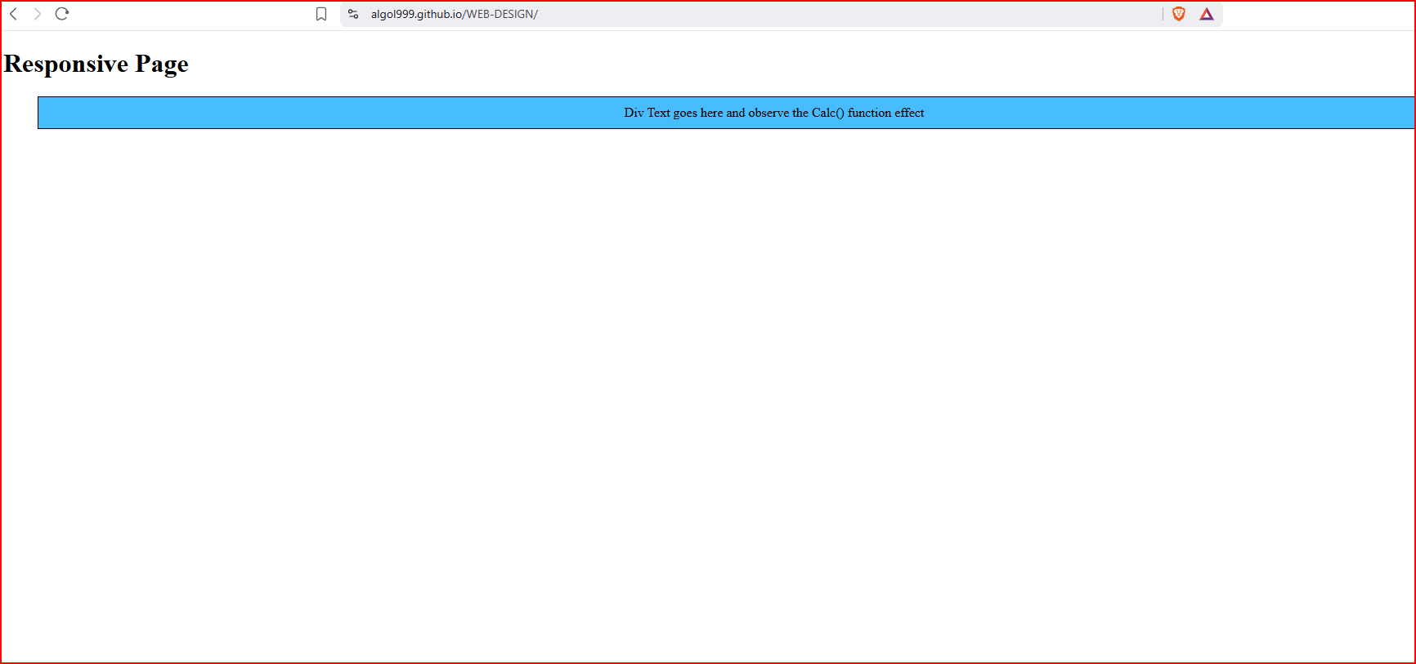
Works well and viewed in tablet and the phone as well as the desktop/laptop.

Slide 21
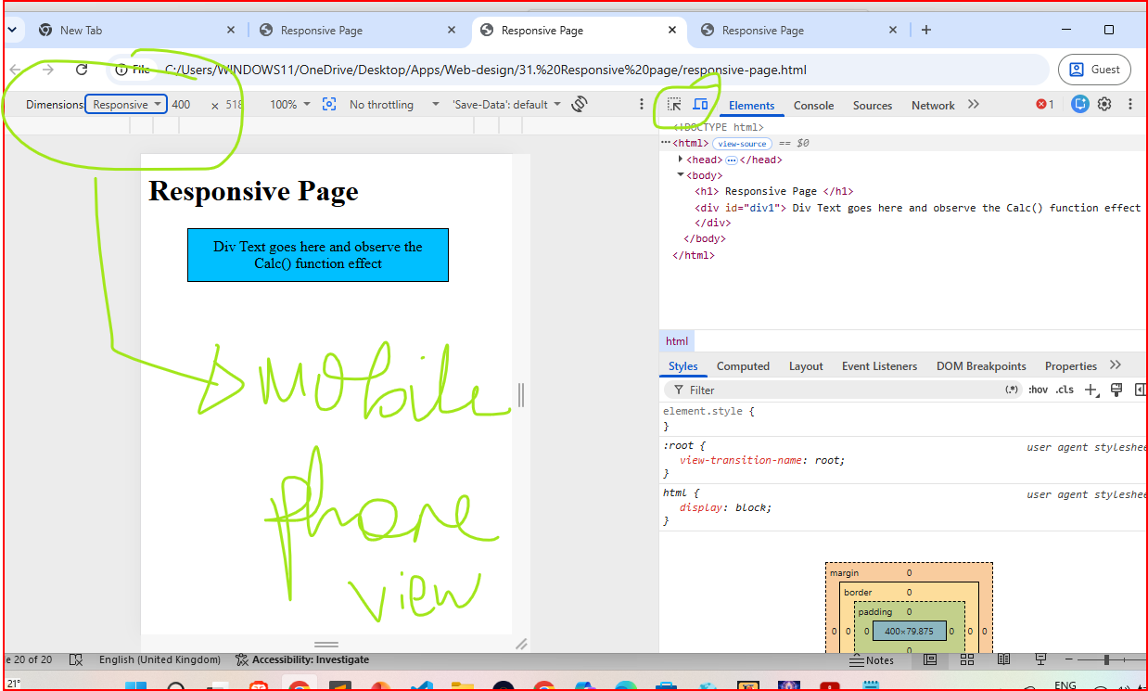
Notes:
Click F12 on laptop/desktop then the “Elements” tab in the Developer window. You can then view the tablet dimensions, Mobile-phone dimensions to ensure the text is fully available on different devices.

Slide 22
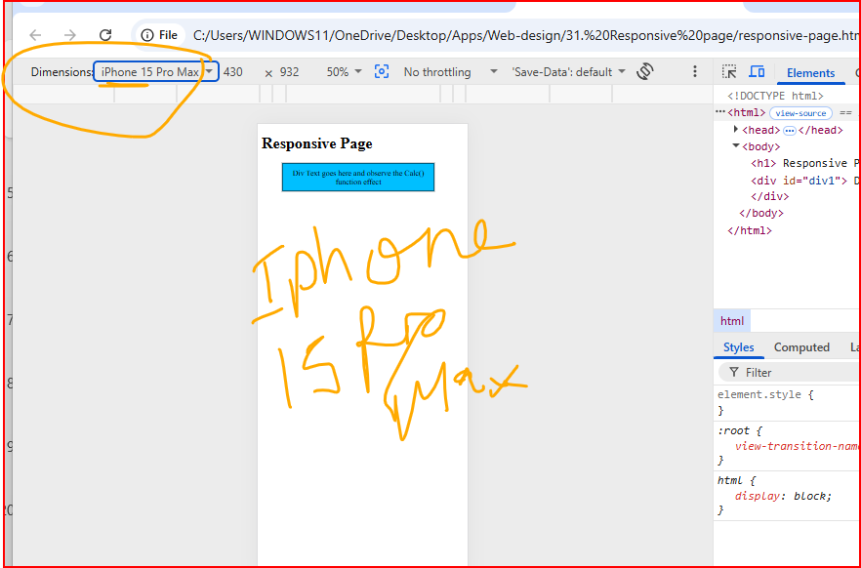

Slide 23
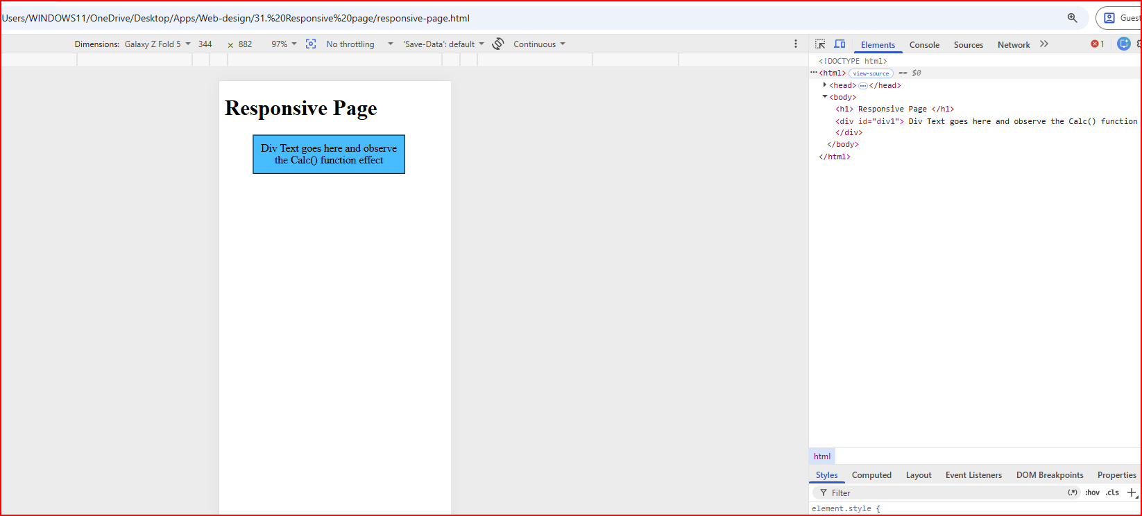
Galaxy – Z : Fold mobile-phone.
Notes:
Galaxy Z – Fold phone.

Slide 24
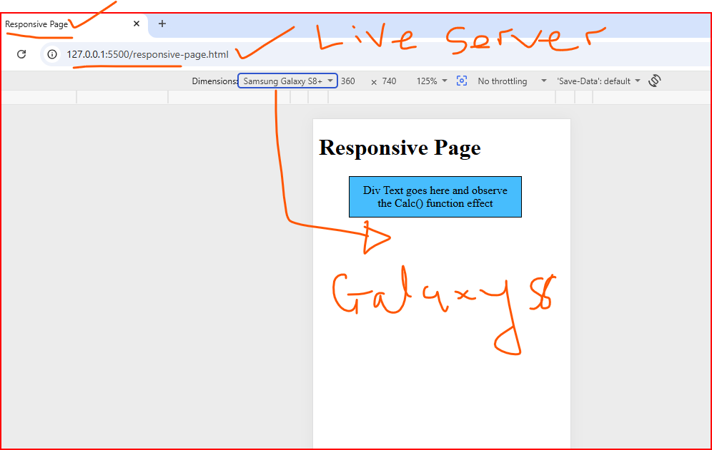
Notes:
Samsun Galaxy S8 view of text – showing correctly.

Slide 25
